Slide 1


C# DEV/CONNECT
Twitter: @CSDevConnect #CSDevConnect
Email: csharpdevconnect@gmail.com
Github: https://github.com/CSharpDevConnect/
Hosted by

Slide 2
The basics of threading
Christopher Sippel

Slide 3
Agenda
Who the heck is talking and why should I care?
Keywords
Basic explanation of Threading
.NET 2.0
How to make a Thread object
How to kill a thread
Background Workers

Slide 4
Cont.
.NET 4.5
Async/Await
Tasks
Questions
Potential Exercises

Slide 5
Who the heck is this guy?
Chris Sippel
Developing software for 9 years
Graduated from Conestoga College in 2014
Has 8 apps on the Windows Phone Market Place with a total of 11,000 downloads
LinkedIn: https://www.linkedin.com/in/chrissippel
Twitter: @Chris_Sippel
Email: chris.sippel@magnetforensics.com
chris_sippel@hotmail.com
Notes:
I started developing software since high school, I then went onto to Conestoga College for the Software Engineering Technology course for 4 years, 16 months of which was spent at Magnet, and I’ve been working at Magnet since I graduated early last year.

Slide 6
Keywords
Delegate
Starving
Threadpool
Tight Loop
Notes:
Delegate – A block of code, the same thing as a method or function
Starving – When you starve a thread, you don’t give it enough resources to execute
Threadpool – A collection of threads that work asynchronously for the application
Tight Loop – When a thread doesn’t give up the CPU to other applications

Slide 7
What is Threading
Threads are the basic unit to which an operating system allocates processor time, and more than one thread can be executing code inside that process [1]
In layman terms a thread is a block of code that is running
C# application have two primary threads, the UI thread and the executing thread
Theoretically your application can have an unlimited number of threads
OS keeps track of threads information such as: stack, register values, etc., when a thread is stopped
Threads in .NET 2.0 can be assigned an importance level
[1] http://msdn.microsoft.com/en-CA/library/aa720724(v=vs.71).aspx
Notes:
1.Taken from MSDN
3.The UI thread is what allows you to interact with your application, buttons, status bars, lists, etc. while the executing thread is the thread that runs the code of your application. There are more threads than just the two, but we’ll ignore those for now.
4.Too many threads leads to poor resource allocation, in that each thread get such little processor time that they basically stop executing
5.The operating system keeps track of your threads’ information, which means you don’t have to worry about saving state when threads start and stop executing
6.These levels of importance determine how much processor time the Thread receives

Slide 8
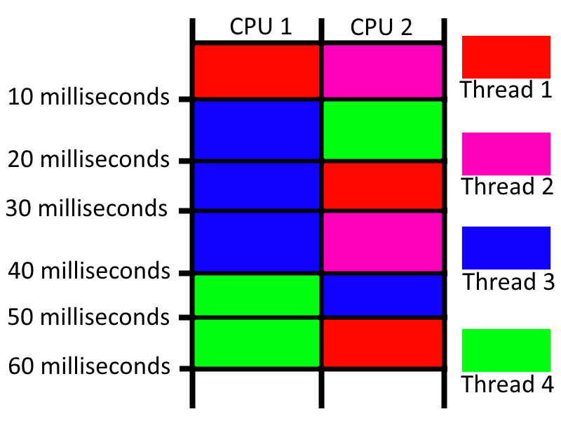
Notes:
From 0 to 10 milliseconds Threads 1 and 2 get time on the processor.
From 10 to 20 milliseconds Threads 3 and 4 get time on the processor.
This means each thread has the same level of importance.
From 20 to 30 milliseconds Threads 3 and 1 get time on the processor .
From 30 to 40 milliseconds Threads 3 and 2 get time on the processor.
This means Thread 3 has a higher importance than all other threads in the application.
From 40 to 50 milliseconds Threads 3 and 4 get time on the processor.
From 50 to 60 milliseconds Threads 1 and 4 get time on the processor.
This means Thread 4 has a higher importance than the other threads.
If a 3 tiered level of importance is assumed, assign a level of importance to each thread.

Slide 9
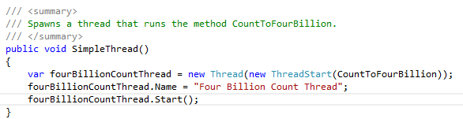
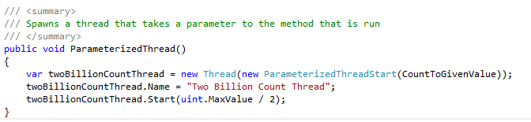
.NET 2.0 - Starting a Thread
Creating a Thread using a ThreadStart that takes a method
Creating a Thread using a ParameterizedThreadStart that takes a method
Notes:
The following three slides are all different ways to start a Thread.

Slide 10
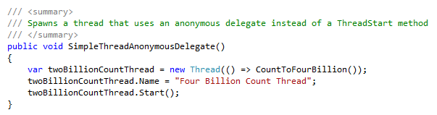
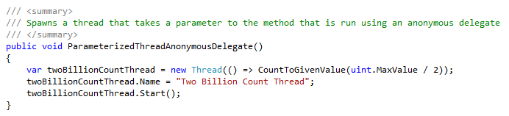
Cont.
Creating a Thread using an anonymous delegate
Creating a Thread using an anonymous delegate that takes a parameter

Slide 11
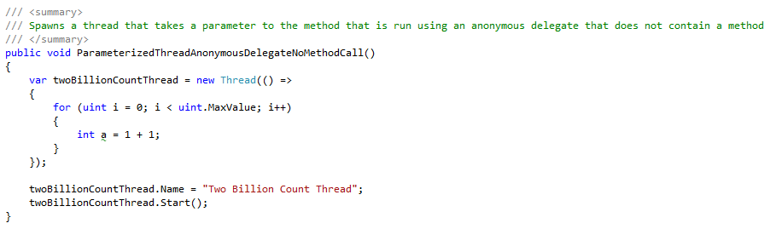
Cont.
Creating a Thread using an anonymous delegate

Slide 12
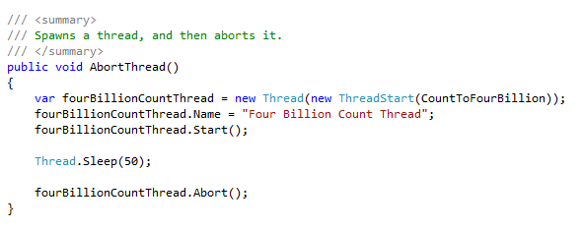
.NET 2.0 - Aborting Threads
Creating a Thread using a ThreadStart object then terminate it after 50 milliseconds

Slide 13
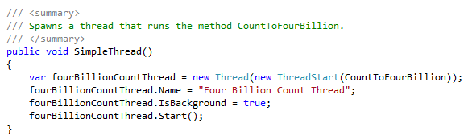
.NET 2.0 – Background Worker
Creating and starting a Thread and setting the IsBackground property to True
Notes:
Threads have a property called “IsBackground” which, as you can guess, turns the Thread into a background thread. A Background Thread will terminate when the application terminates, but if an application terminates and a Thread that was not set as Background is still running, the application will still be running. It may appear the application has closed because the form is gone, if you look at a process monitor you’ll still see the application. The IsBackground property is set to False by default.

Slide 14
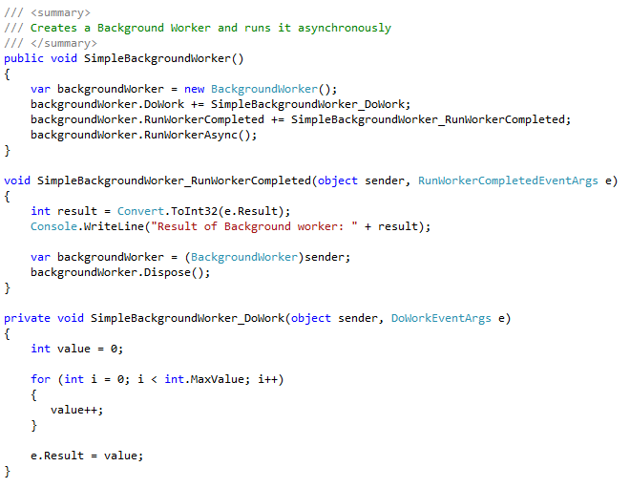
Cont.
Notes:
Or, a potentially better way of handling a thread that is supposed to run in the Background is a BackgroundWorker object. A Background worker is wrapper around a Thread object that some may feel is better than using a Thread object.
Make sure to dispose of any BackgroundWorkers, or else you’ll have a memory leak on your hands.

Slide 15
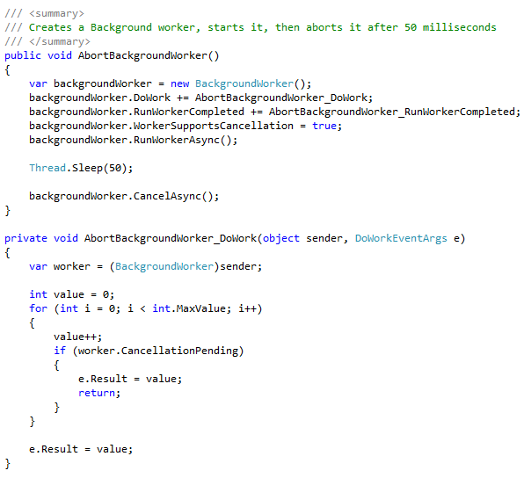
Background Worker - Cancelling
Notes:
This is how to cancel a BackgroundWorker after it has already started.
You need to make sure to set WorkerSupportsCancellation to true or else you will get an exception when you call CancelAsync()
You need to check for CancellationPending in the code that is run by the Thread, or else there is the possibility of the cancellation not happening before the Thread finishes by itself.

Slide 16
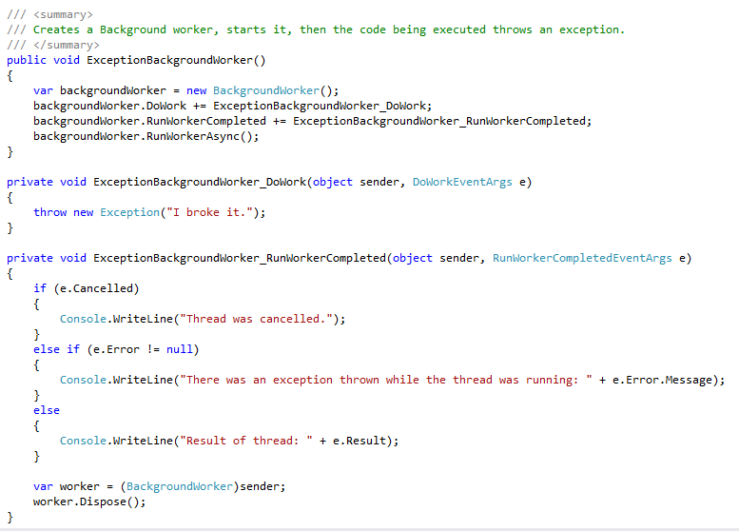
Cont.
Notes:
Exceptions are popped up when they occur, so make sure you handle any exception accordingly in the RunWorkerCompleted() method

Slide 17
Questions?

Slide 18
.NET 4.5 Async/Await
Can be used in .NET 4.5
Uses the async and await keywords and the Task object
Async is different than parallel
Async method names should end with Async
Avoid async void methods, the one exception is event handlers
The biggest advantage of async/await is not needing to worry about thread managment
Notes:
The async and await keywords were released in .NET 4.0 BUT they act differently in .NET 4.5
The async keyword is used in method signatures to indicate a method can be run asynchronously
The await keyword is used inside of async methods to allow for the actual asychronousy
There is the parallel object in C# and async operations are not the same
The current standard for methods that are supposed to be used using the await operator should end in Async to indicate they are asynchronous methods
Async methods should always return something, if they aren’t returning something they probably don’t need to be async. The one exception is event handlers since they can’t usually don’t return a value.
The biggest advantage of async/await is that you don’t need to worry about manage your threads and make sure you don’t need to worry about starving a thread

Slide 19
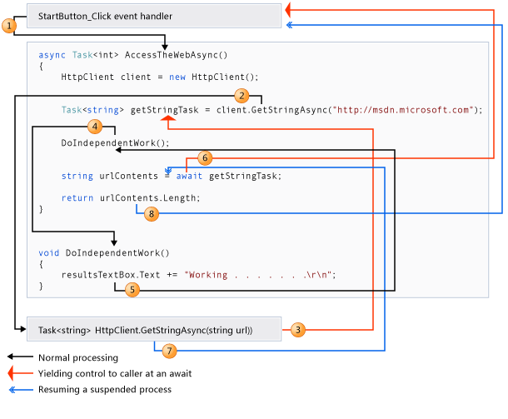
Keywords
Async
Await
Task
Image taken from: http://msdn.microsoft.com/en-us/library/hh191443.aspx
Notes:
Async – used to signify a method is supposed to be run asynchronously
Await – The keyword that allows a method to wait for an asynchronous method to finish and then resume processing
Task – Has two uses. First, an asynchronous method must return a Task object or Task<T>. Second can be used to run/start an asynchronous method.
Image taken from MSDN: http://msdn.microsoft.com/en-us/library/hh191443.aspx

Slide 20
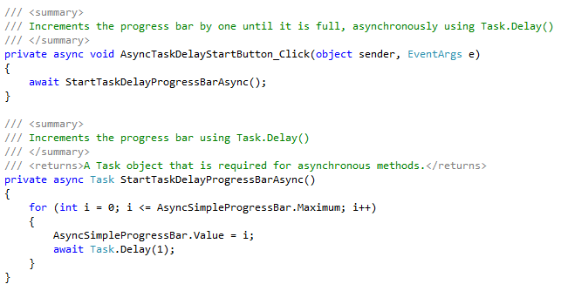
Async/Await - Basic Sample
Notes:
Here we have an async event handler calling an async method that doesn’t return anything. Remember how I said don’t do this?
If you don’t have await in front of an async method it will be treated synchronously. Don’t worry though, Visual Studio will let you know.
The Task object needs to be returned from async methods.
The reason we are able to access the AsyncSampleProgessBar is because async/await operators don’t create a new thread.
Task.Delay is the same as Thread.Sleep() but can awaited upon

Slide 21
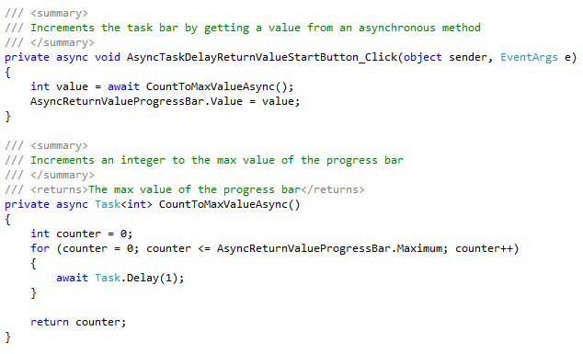
Async/Await - Return Values
Notes:
Here we have an async event handler calling an async method that returns an integer.
Again, we set the event handler to be async because it uses the await keyword
Notice that CountToMaxValueAsync ends with Async, this is supposed to tell the person who uses your API that this method is supposed to be used Asynchronously
Notice we use return Task<int> as opposed to Task like last time, this indicates the return value of the async method is an int

Slide 22
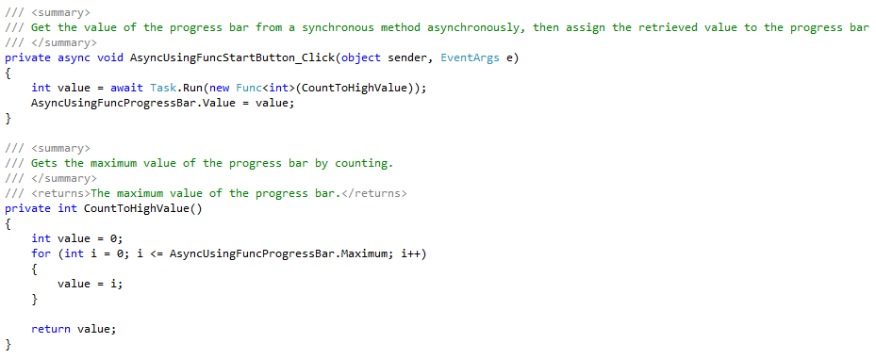
Async/Await - Synch method asynchronously
Notes:
Here we have an async event handler calling a synchronous method
You may have noticed asynchronous methods need to call other asynchronous method, this can lead to your whole chain of methods being asynchronous.
This can slow down your program if you want to do something and not have it be asynchronous, ie. counting to a value. You’ll notice in the previous example we needed to use Task.Delay to make the method asyncronous and that in turns slows down the method.
Task.Run is different than the async and await operators by one big difference, it may or may not create a new thread. You have no control other this thread, unlike the Thread object BUT you shouldn’t have need to access the thread since async/await make everything easier

Slide 23
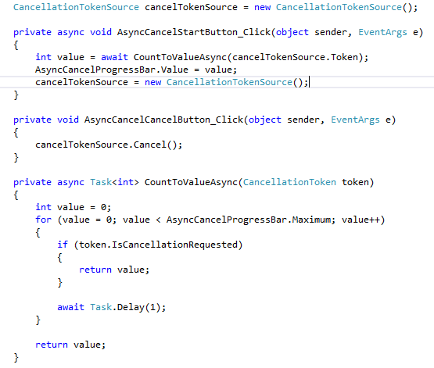
Async/Await - Cancel
Notes:
Here we have an asynchronous method calling an asynchronous method that it can cancel
The set-up using async, await and Task are the same, the new object is the CancellationTokenSource.
The source is what allows you to trigger a cancel for an asynchronous method
You can cause a cancel immediately, or after a given amount of time
You can cause an exception to be thrown when the cancellation is called

Slide 24
Contact Information
Chris Sippel
LinkedIn: https://www.linkedin.com/in/chrissippel
Twitter: @Chris_Sippel
Email: chris.sippel@magnetforensics.com
chris_sippel@hotmail.com

Slide 25
Potential Exercises - Easy
Prime number retrieval
Make a program that takes in pairs of numbers. Then get the prime numbers between each pair of numbers.
What you learn
How to spawn a thread
How to pass parameters to a task/thread
How to handle the return value(s) of a thread

Slide 26
Potential Exercises - Medium
Simple Web Browser
Create a simple web browser with a go and cancel button as a minimum
What you learn
How to use a .NET Async method, WebClient object
How to tell the user something is happening
How to cancel a task/thread

Slide 27
Potential Exercise - Hard
Simple Chat Client
Create a client and server that allows people to create rooms to talk in
What you learn
Thread resources, and how to properly manage how many threads so you don’t starve threads.

Slide 28
C# DEV/CONNECT
Twitter: @CSDevConnect #CSDevConnect
Email: csharpdevconnect@gmail.com
Github: https://github.com/CSharpDevConnect/
Hosted by

